Slide 1



www.itonlinelearning.com
Exam Prep Session

Slide 2

Exam Information
Duration: 60 minutes
Number of questions: 60
Marks: Each question is worth 1 mark. There are 60 marks available. There are no ‘trial’ questions and no negative marking.
Pass mark: 60% or higher – a raw score of 36 marks or above

Slide 3
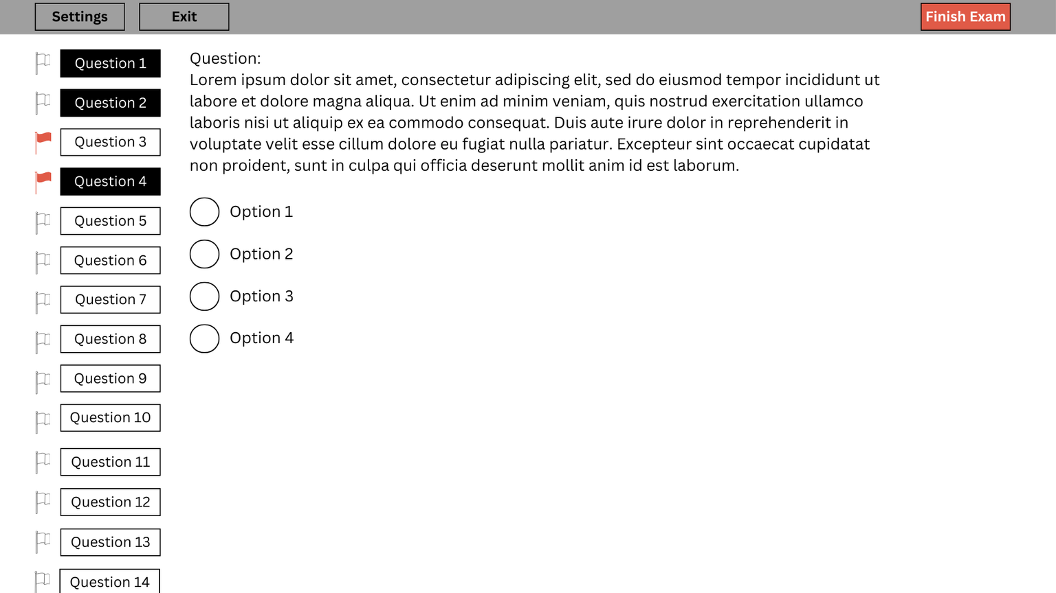
Exam Layout

Slide 4
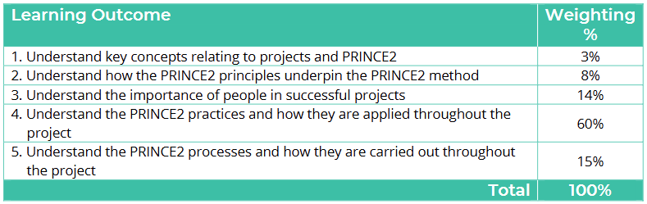
Tips & Tricks

Slide 5
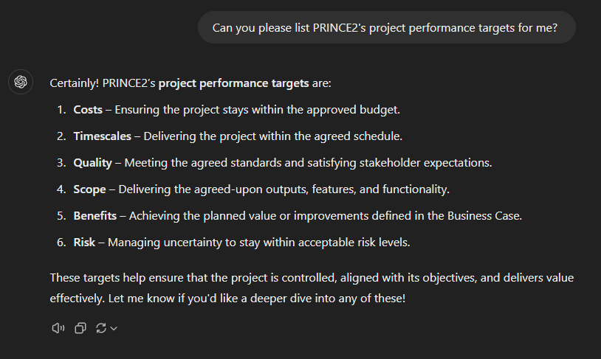
ChatGPT

Slide 6
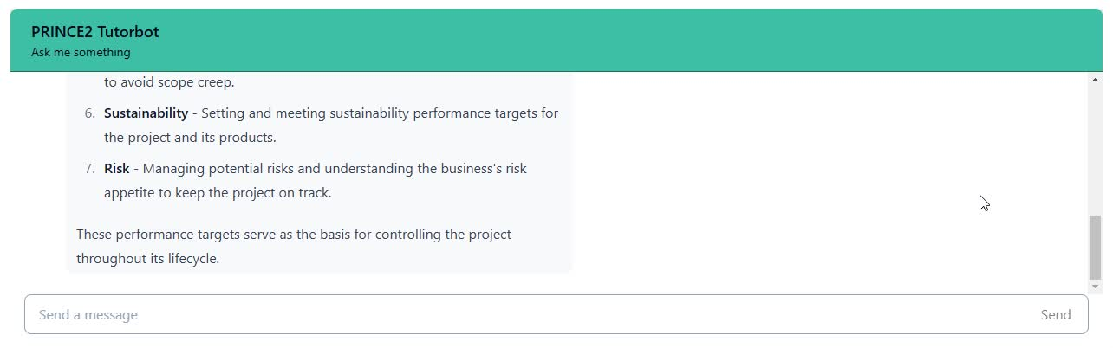
TutorBot

Slide 7
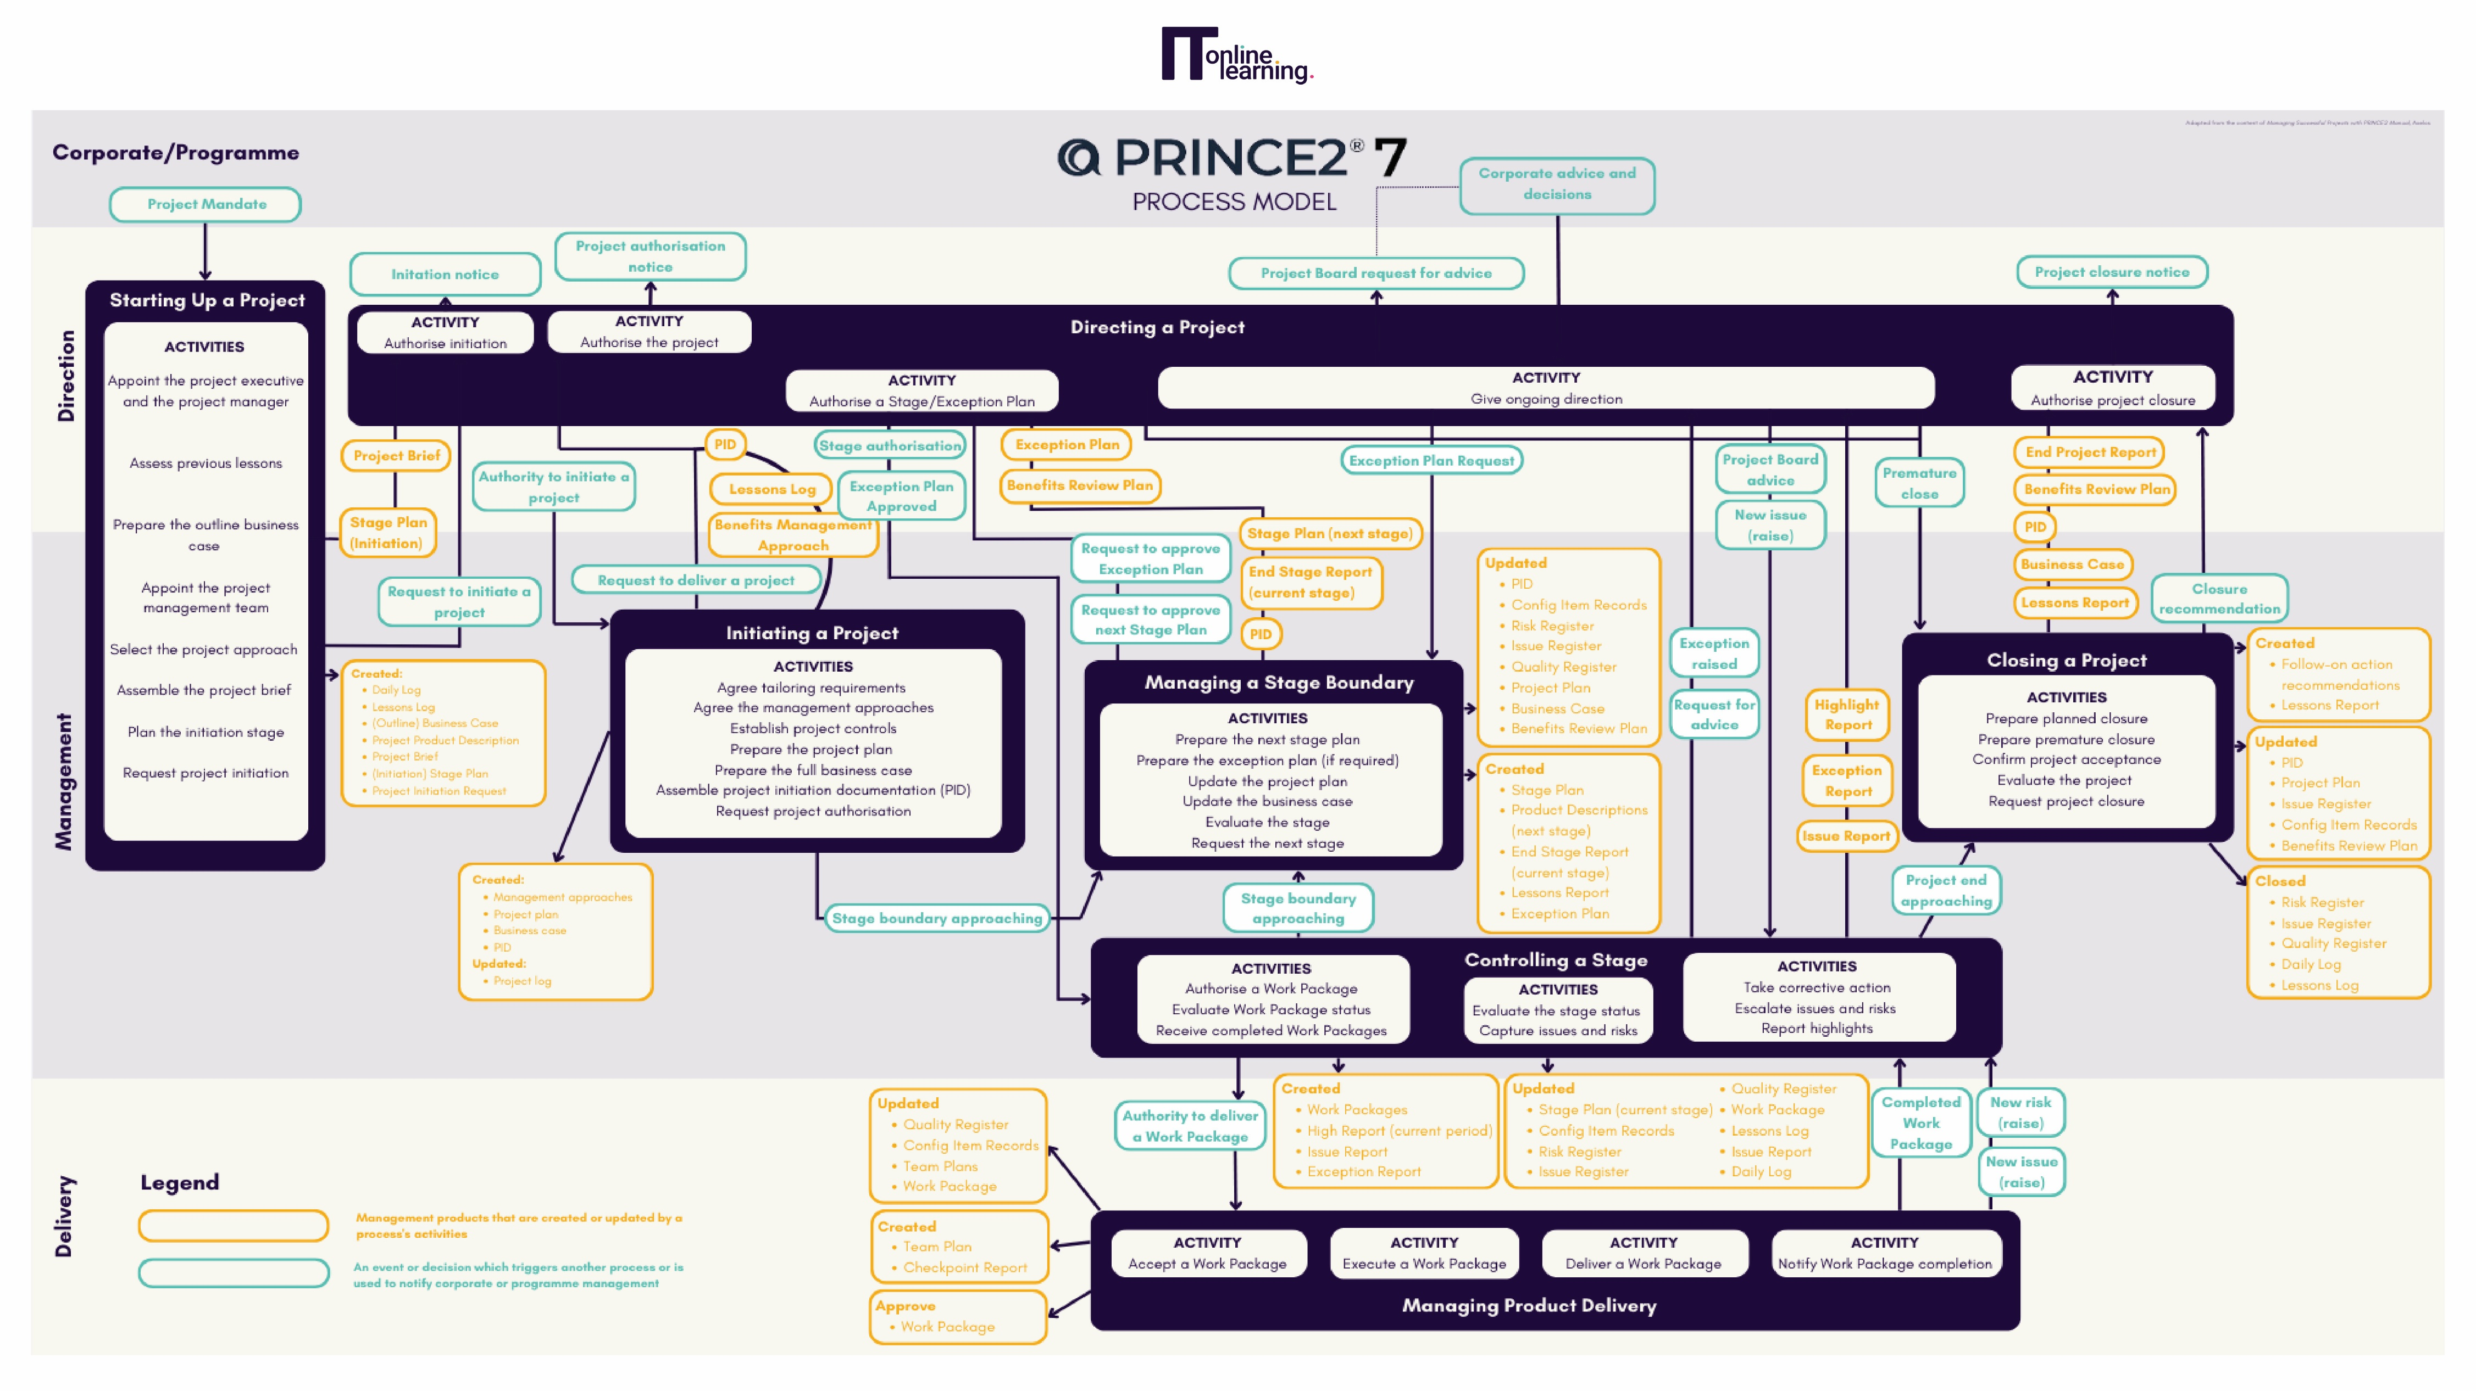

Slide 8

During Your Exam
  Make sure your exam environment is quiet
  Do not read the questions out loud
  You require a camera (360-degree or embedded)
  The door to the room you are in must be visible throughout your exam
https://www.peoplecert.org/ways-to-get-certified/examshield-guidelines
  Do not bring anything into your exam room with you
  Keyword identification
  Dummy answers
  Process of elimination
  Accessing your digital manual

Slide 9

Question 4
An external IT company is being appointed to deliver a new accounting system as part of a project. Which principle is being applied when agreeing the contract with the IT company?
A. Define roles, responsibilities and relationships
B. Manage by stages
C. Manage by exception
D. Tailor to suit the project

Slide 10


Manage by exception
Question 5
Directing
What does the ‘manage by exception’ principle enable?
A. Decisions to be made by the right people, at the right time
B. The project to deliver benefits required by the business
C. The project team members to understand their contribution to the project
D. The project team to define the scope to be delivered by the project
Managing
Controlling
Manage by stages
Stage
Stage
Stage

Slide 11

Question 7
The project manager has recommended that some of the management products for the project should be combined. In which management product should this be documented?
A. Project plan
B. Project initiation documentation
C. Stage plan
D. Business case

Slide 12

Question 11
Which activity should be managed carefully as part of 'leading across organisational boundaries' since it can be performed by people that are outside the project team?
A. Delivering the products to the agreed quality specifications
B. Integrating new products into each impacted area of the business
C. Gaining commitment for the realisation of benefits post-project
D. Securing funding from the business layer for the business case

Slide 13


THANK YOU FOR JOINING US
Please take a moment to leave us a review so that we can continue to host these sessions and help you ace your exams.

