Slide 1

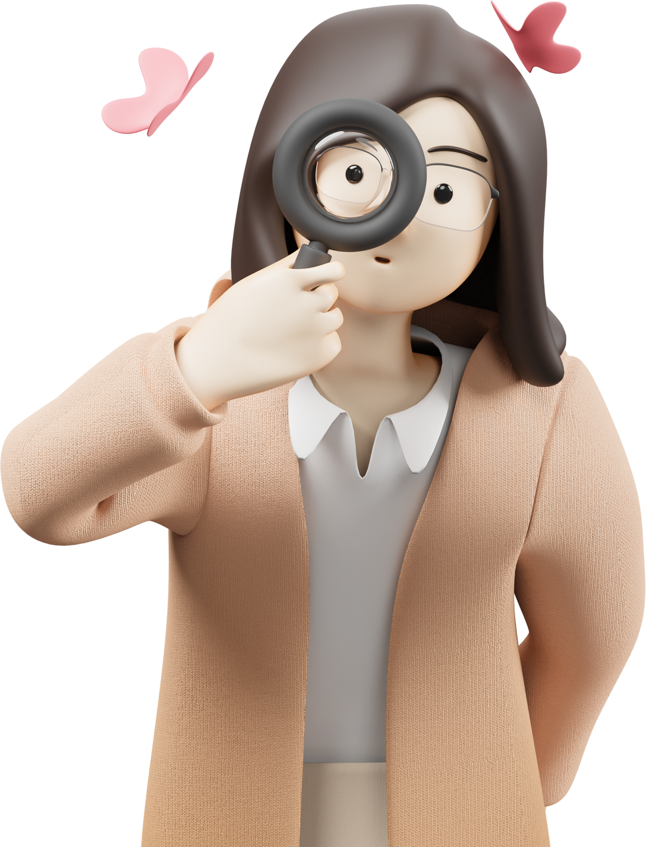
www.itonlinelearning.com
Figures & Characters for Each MBTI Trait
Additional Material

Slide 2
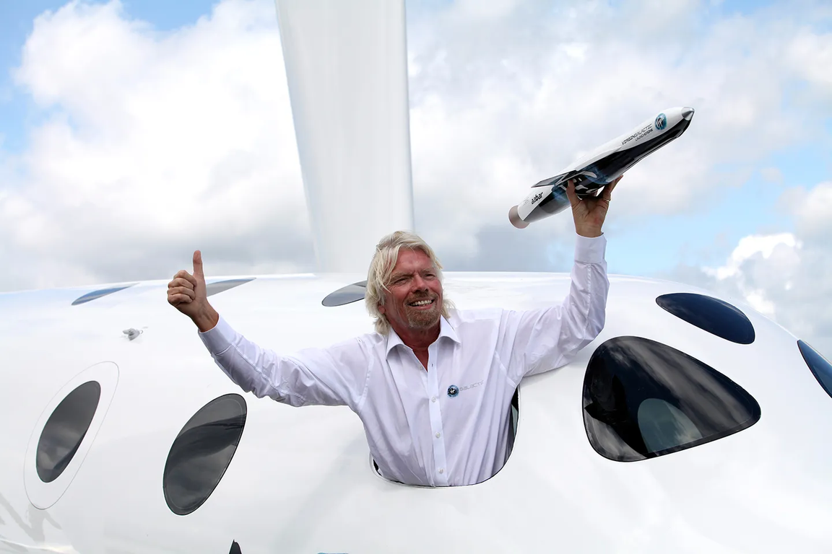
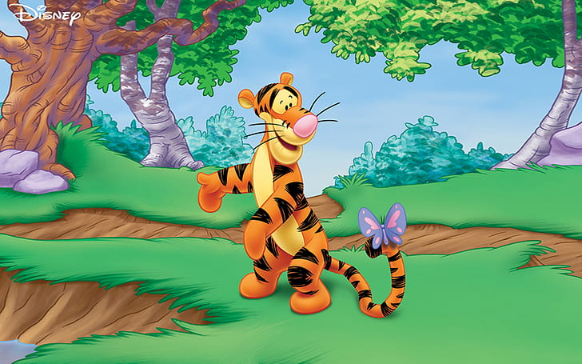
Extraversion
Our resident extraverts:
  Tigger from Winnie the Pooh (energetic & outgoing)
  Richard Branson (entrepreneur & adventurer, known for his outgoing and sociable nature)
Traits:
  energised by the external world
  like talking to people and being sociable
  like to learn by activity and talk
  lots of interests
  speak first, think about it later
  like starting new things

Slide 3
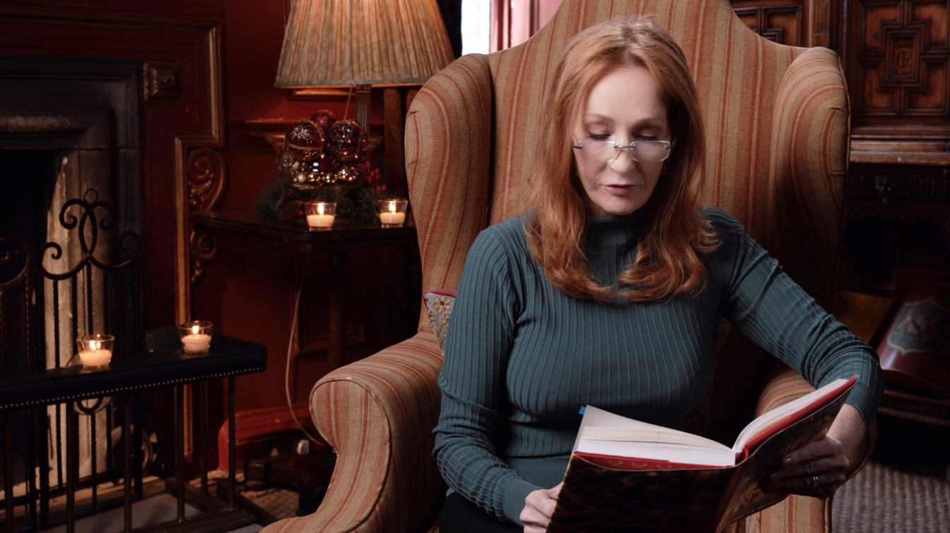
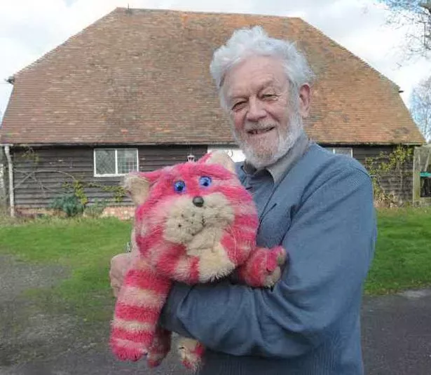
Intraversion
Our resident intraverts:
  Bagpuss (calm and introspective)
  J.K. Rowling (author, known for her introverted qualities and focus on inner thoughts)
Traits:
  energised by their own inner world
  enjoy their own thoughts & feelings
  prefer writing to express their ideas
  a reflective learner
  fewer, more serious interests
  think before they speak

Slide 4
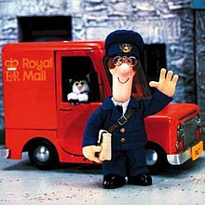
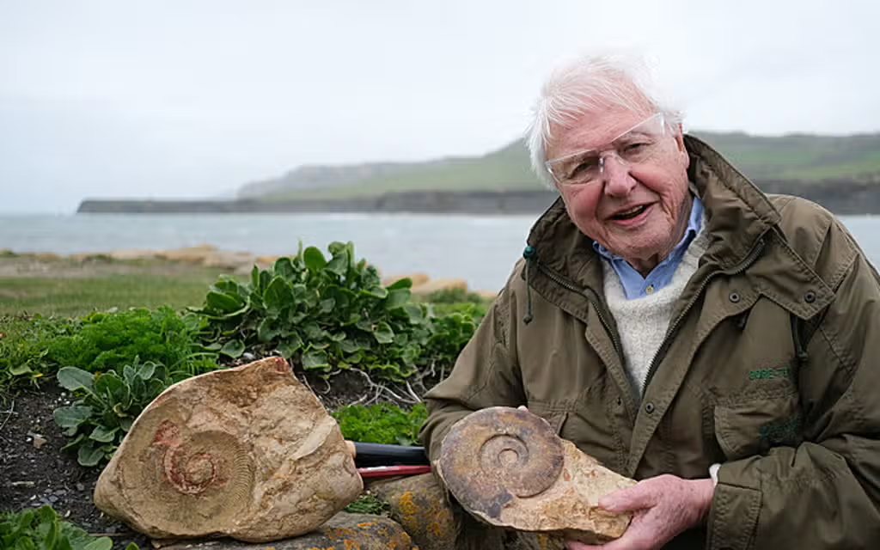
Sensing individuals you might know:
  Postman Pat (pays attention to details)
  David Attenborough (naturalist, known for attention to detail in his documentaries)
Sensing
Traits:
  focus on sensory data
  focus on what their senses tell them
  pay attention to definite, detailed facts
  notice things in an orderly way
  like getting information in clear stages
  'here and now' approach, trust experience

Slide 5
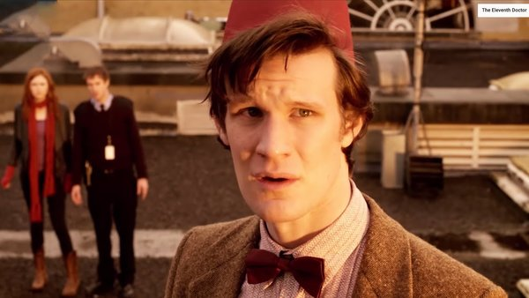
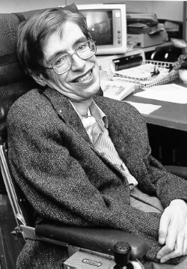
Intuiting individuals you might know:
  The Doctor from Doctor Who (focuses on possibilities and the future)
  Stephen Hawking (theoretical physicist, a visionary in the scientific community)
Intuiting
Traits:
  focus on interpretations and intuitions
  a 'big picture' person
  look behind facts for meaning
  future-oriented
  willing to trust intuitions

Slide 6
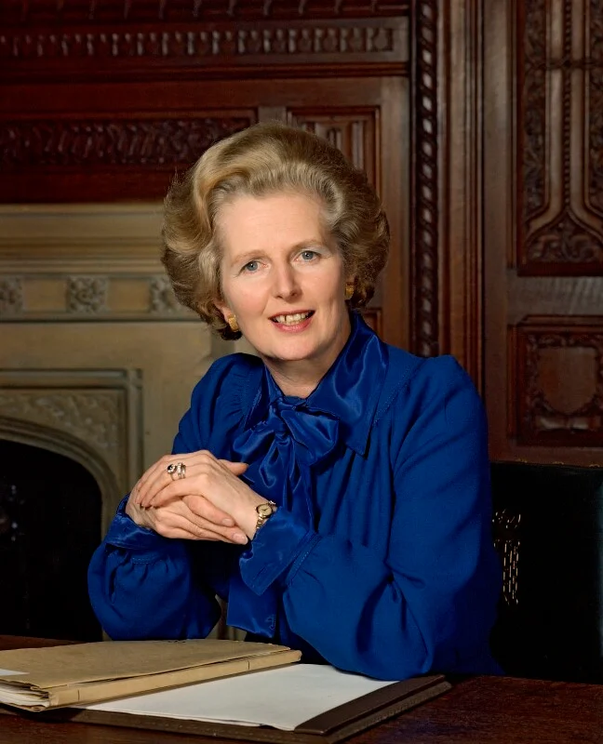
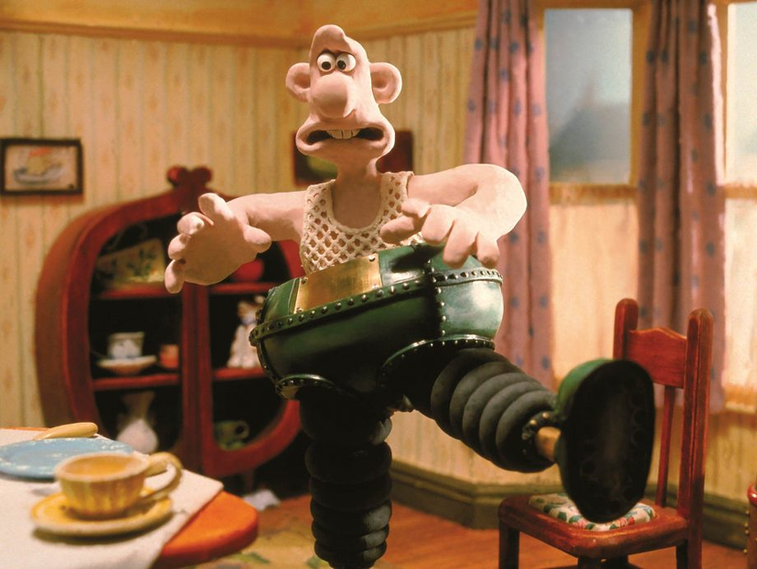
Thinking
Thinking individuals you might know:
  Wallace from Wallace and Gromit (inventive and logical mind)
  Margaret Thatcher (Former British Prime Minister, known for logical decision-making)
Traits:
  make decisions based on rational thought
  treat problems with logic
  cause-and-effect reasoning
  tough minded
  look for the objectively 'right' answer
  appreciate just solutions

Slide 7
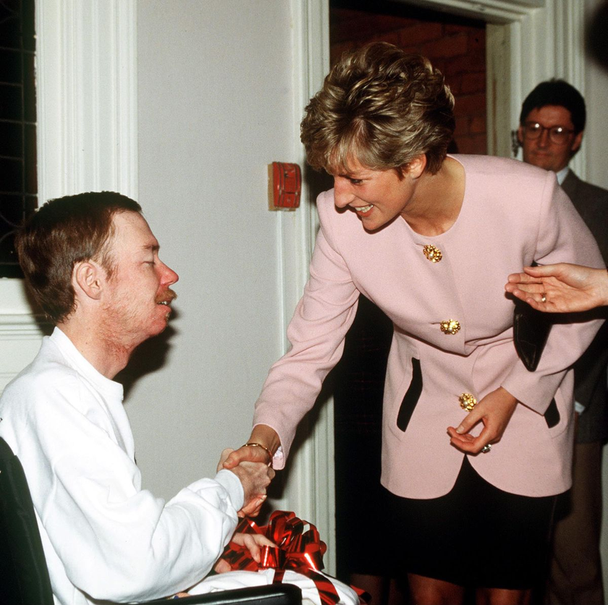
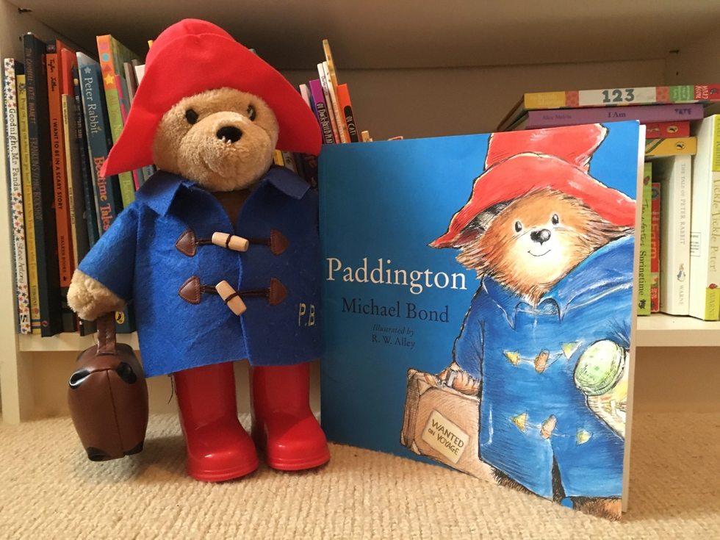
Feeling
Feeling individuals you might know:
  Paddington Bear (known for his kindness and consideration for others)
  Princess Diana (known for decisions based on empathy and compassion)
Traits:
  make decisions through sensitive feelings
  with empathy/consideration for others
  with compassion
  based on values and beliefs
  seeking a widely accepted outcome
  open to and accepting of others

Slide 8
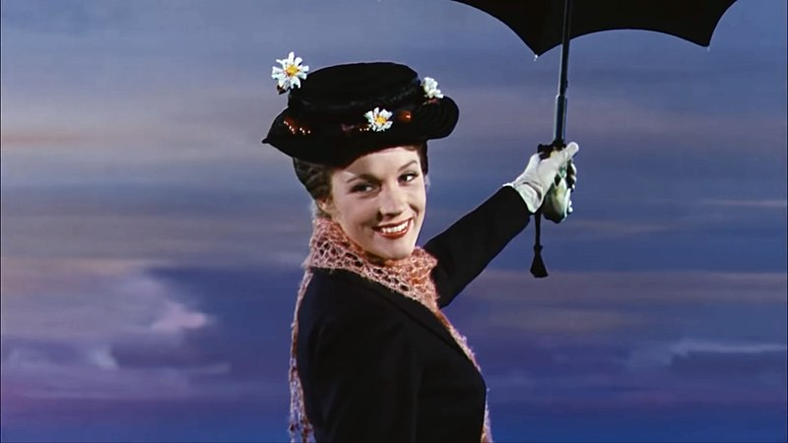
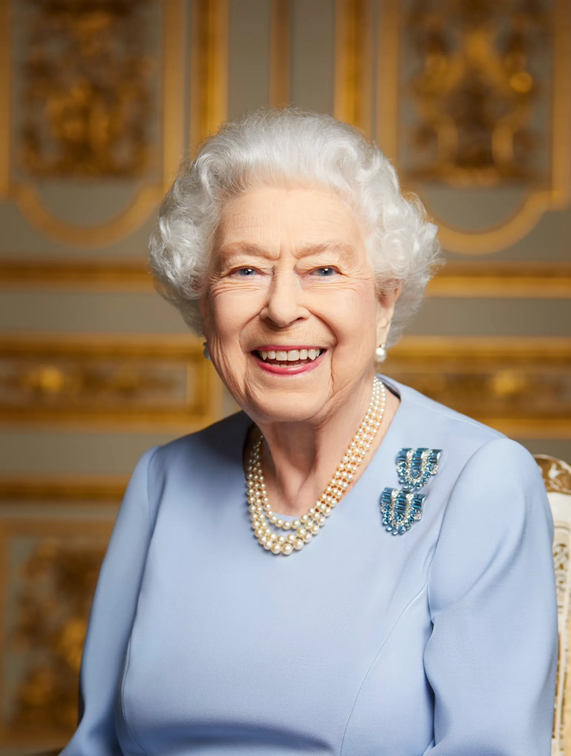
Judging individuals you might know:
  Mary Poppins (organised and planning-oriented nanny)
  Queen Elizabeth II (known for her systematic and methodical approach to her duties)
Judging
Traits:
  prefer situations to be cut and dried and clear
  work to a timetable
  systematic and methodical
  like to plan
  appreciate closure on decisions
  dislike the pressure of leaving things late

Slide 9
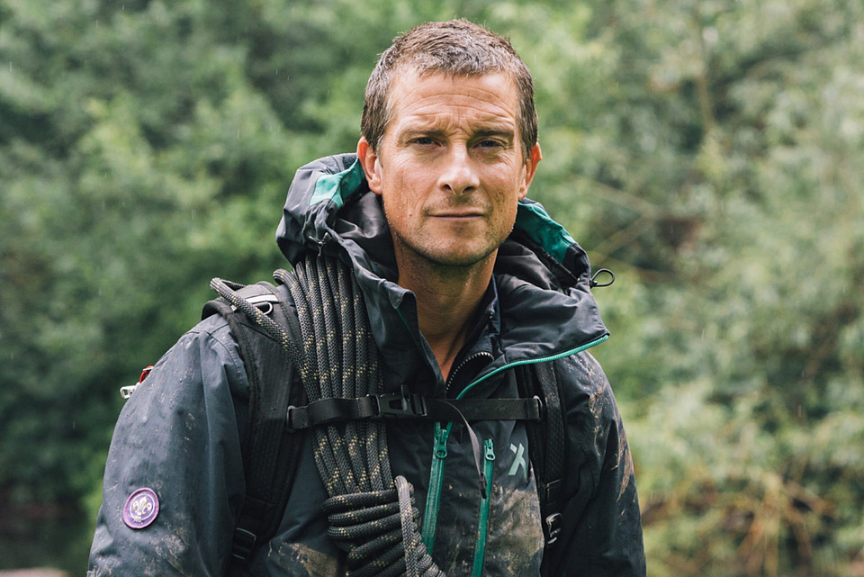
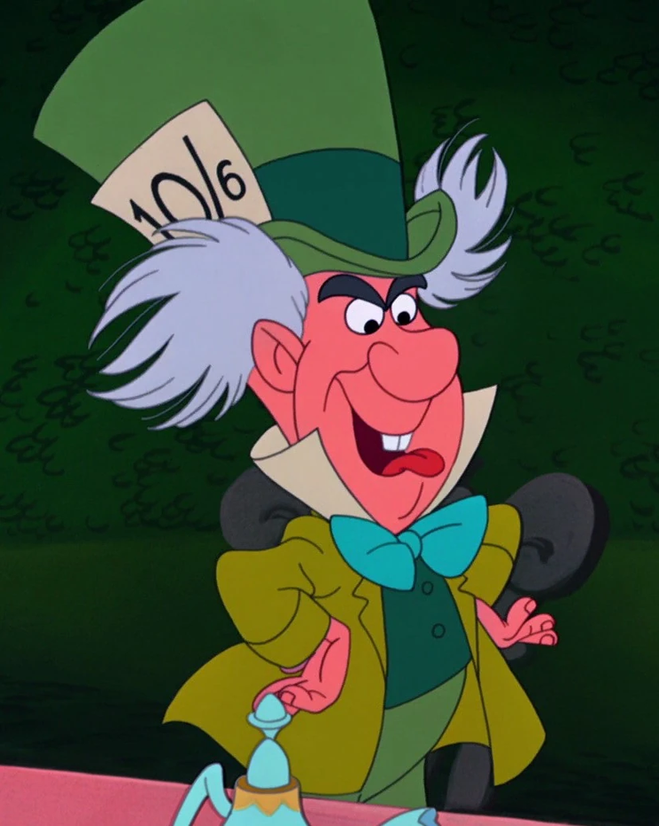
Perceiving individuals you might know:
  The Mad Hatter (spontaneous and embraces ambiguity)
  Bear Grylls (known for his adventurous and spontaneous approach to survival challenges)
Perceiving
Traits:
  prefer 'open-ended' and ambiguous situations
  spontaneous
  happy with ambiguity
  like to be flexible and adaptable
  dislike restrictive systems, detailed plans
  positively enjoy 'urgent' work

