Slide 1



www.itonlinelearning.com
Practitioner Exam Prep Session

Slide 2

Exam Information
Duration: 2.5 hours
Questions: 50 scenario-based multiple-choice questions
Marks: Each question is worth 1 mark. There are 50 marks available. There are no ‘trial’ questions and no negative marking.
Pass Mark: 60% or higher - a raw score of 30 out of 50
Material Permitted: The PRINCE2 Agile official manual may be used.

Slide 3
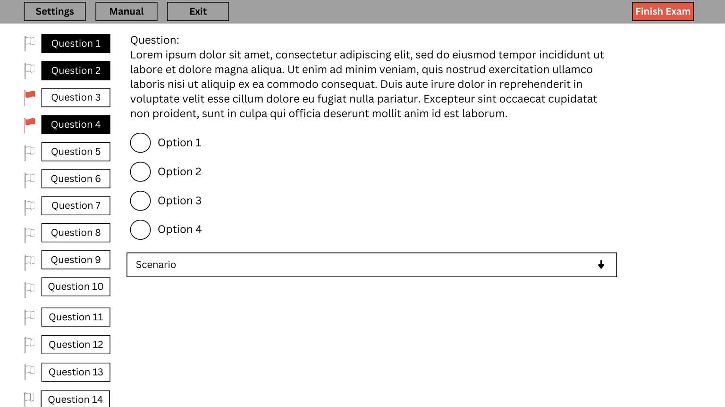

Exam Layout

Slide 4

If you have a hardcopy manual...
You may:
  Use Post-it® notes as long as the titles are brief
  Make notes in your manual (on blank pages or in margins)
You will NOT be permitted to:
  Add more pages to the manual
You should:
  Highlight the corresponding content when following your syllabus and the manual references

Slide 5

If you have a digital manual...
  You will be able to access your manual in the official exam using the button on the top left-hand corner that reads “Official Manual” of your exam screen
  Anything you have highlighted in your digital manual on the PeopleCert portal will be highlighted in your official exam
  You will still be able to use the search functionality as you do with your current digital manual
  You should highlight the corresponding content when following your syllabus and the manual references
  You may view your full eBook on a second portable device such as Smartphones, Tablets, or Laptops

Slide 6

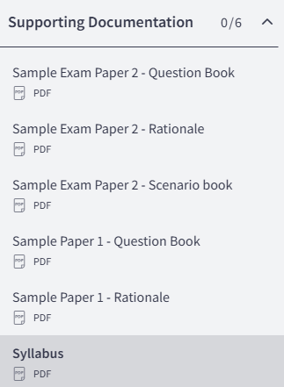
Key Resources

Slide 7

Glossary of Terms
  Please email your tutor for the PRINCE2 Agile Glossary if you do not already have it
  Use this glossary for keyword identification and to make sure you are confident in your knowledge of these terms before your official exam

Slide 8
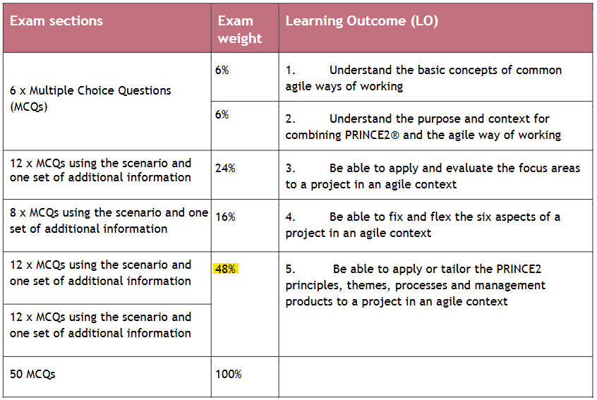
Tips and Tricks

Slide 9

During Your Exam
  Make sure your exam environment is quiet
  Do not read the questions out loud
  You require a camera (360-degree or embedded)
  The door to the room you are in must be visible throughout your exam
https://www.peoplecert.org/ways-to-get-certified/examshield-guidelines
  Try not to use the manual for every question
  Keyword identification
  Dummy answers
  Process of elimination

Slide 10
Project Scenario: Chesterton’s Cheese
The Chesterton family started out as farmers, and four years ago they successfully moved into the making and selling of a wide range of cheeses. They now employ 80 people. Chesterton’s sell most of their cheese to national supermarkets (referred to as ‘trade customers’).
However, two years ago they decided to sell cheese directly to the public by telephone or over the counter at the farm shop. They did this in order to open up a new market in case their trade customers became less profitable. One of their cheeses, the Chesterton Blue, has been nominated for the International Cheese of the Year Award. The winner of this award will be announced at the International Cheese Festival being held in Amsterdam in three months’ time. Chesterton’s are expecting to see a significant increase in demand resulting from the publicity.
In order to cope with the extra demand, Chesterton’s have decided to undertake a project which they have called ‘The Golden Clog Project’.
Scope
The initial scope of the project includes:
  Rebranding of Chesterton’s Cheese;
  Creating a marketing campaign to highlight how successful Chesterton’s have been and to publicise their new branding;
  Moving to new premises where the manufacturing of the cheese and the support office will be in one place;
  Creating a new website.

Slide 11
Project Scenario: Chesterton’s Cheese
The project has been set up with four work streams to deliver this work:
  Rebranding;
  Marketing campaign;
  Website;
  Move Premises.
Project Background
Most of the staff at Chesterton’s have been trained in PRINCE2 Agile. Last year a project office was created to support best practice in the way Chesterton’s worked. Due to the importance of this project, the Directors have decided to release the Board Room for use throughout the project’s duration.
Move Premises - Additional Information
Chesterton’s is currently located across several sites and they want to move to one site as quickly as possible, due to the expected increase in demand. The new premises are very large, and therefore Chesterton’s believe that all of the cheese making can be brought together onto one site. There is a concern about the new premises because the access road is quite narrow and it also has limited space for parking, although alternative parking arrangements are available. The landlord who owns the building lives abroad but has agreed that if Chesterton’s do not like the new premises they can move out, without penalty, as long as they do so within three months of their arrival.

Slide 12
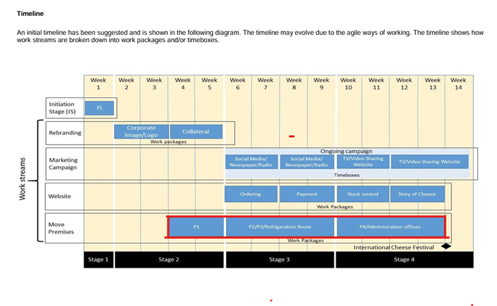
Move Premises - Additional Information
Chesterton’s make several types of cheese and their aim is to have all four production lines fully operational as soon as possible.
There will be a number of work packages in this work stream:
1. Production line:
Move four production lines to the new premises (shown as P1-P4 on the timeline).
2. Refrigeration Room:
Cold storage facilities for both raw produce and manufactured cheese.
3. Administration offices:
Prepare office space ready for all administration staff including those working in IT, Facilities, Operations, Sales, Marketing and Finance. The premises team are not quite sure how the agile ways of working apply to their work in the project but are willing to be guided.

Slide 13
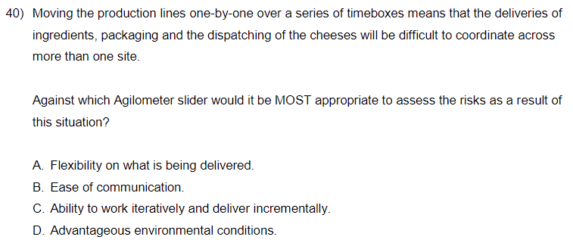

Slide 14
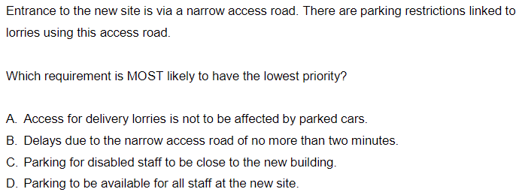

Slide 15
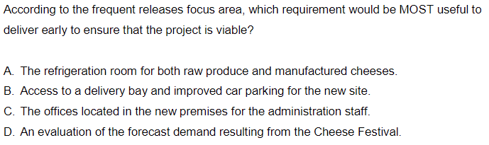

Slide 16
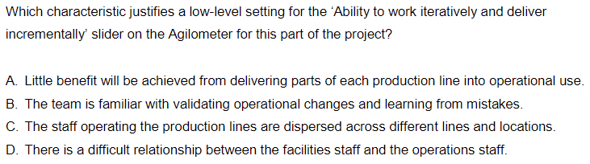

Slide 17
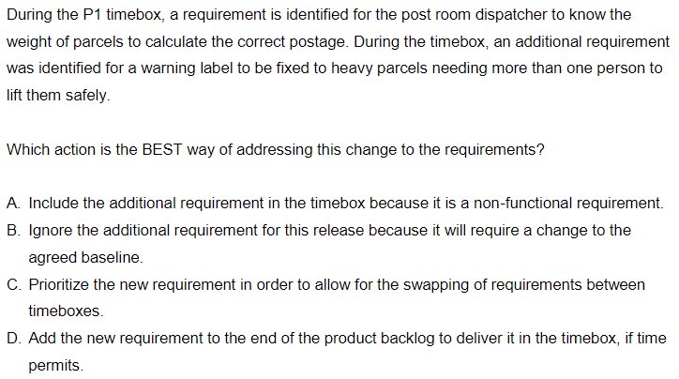

Slide 18

THANK YOU FOR JOINING US
Please take a moment to leave us a review so that we can continue to host these sessions and help you ace your exams.

