Slide 1

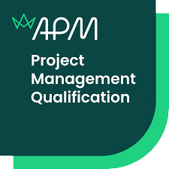

www.itonlinelearning.com
Exam Prep Session

Slide 2

Exam Information
Duration: 2.5 hours
*There are two parts to the exam with an optional break of 30 minutes in between (in addition to the 2.5 hours)
Number of questions: 40
Marks: 90 available
Pass mark: The pass mark for the APM Project Management Qualification will vary between exam versions to take account of slight differences in question difficulty between different exam versions.

Slide 3

Reasonable Adjustments
  Used to support you if you are experiencing a short- or long-term condition or are regarded as disabled in terms of the Equality Act 2010
  Must be submitted to the APM Qualifications Team at least 12 working days before your exam date
  Made on an individual basis and will vary from person to person
  Examples of reasonable adjustments include:
i. Extra time and/or additional rest breaks.
ii. Use of a text reader or screen reader.
iii. Use of a scribe or reader.
iv. Permission to submit handwritten exam scripts.
v. Permission to use specialist equipment.

Slide 4
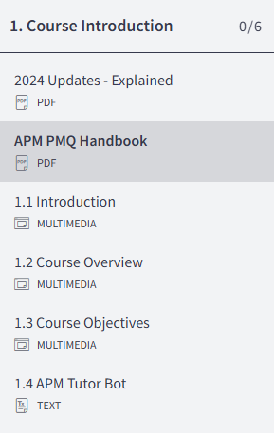
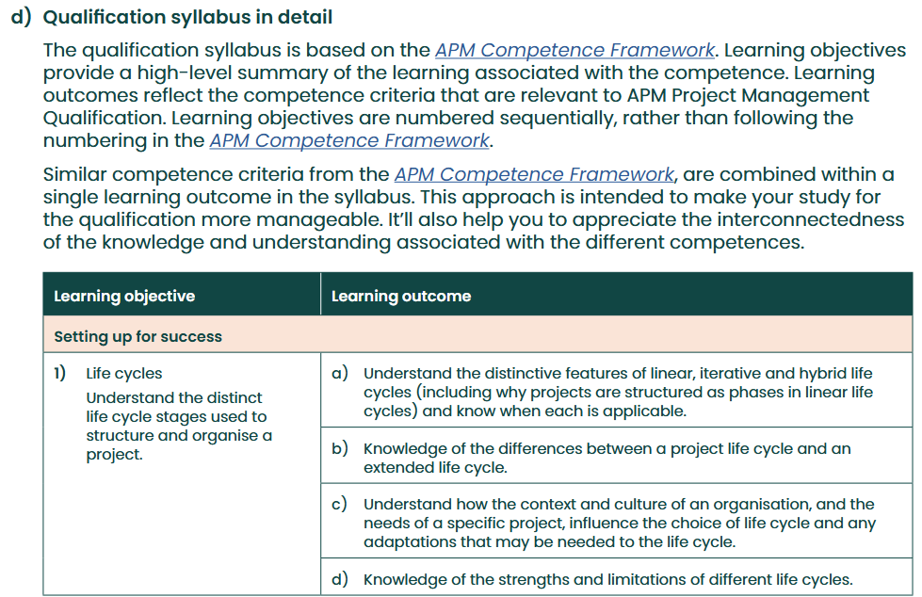
Syllabus
Your learning outcomes are listed from page 9 (APM PMQ Handbook)

Slide 5
Exam Coverage
Your exam coverage for each competence area is listed from page 15 (APM PMQ Handbook)
Competence Area | Exam Coverage
Setting up for success | 15% - 20%
Preparing for change | 15% - 20%
People and behaviours | 25% - 35%
Planning and managing deployment | 30% - 40%

Slide 6

Glossary of Terms
  Please email your tutor for the APM Glossary of Terms if you do not already have it
  Use this glossary for keyword identification and to make sure you are confident in your knowledge of these terms before your official exam

Slide 7
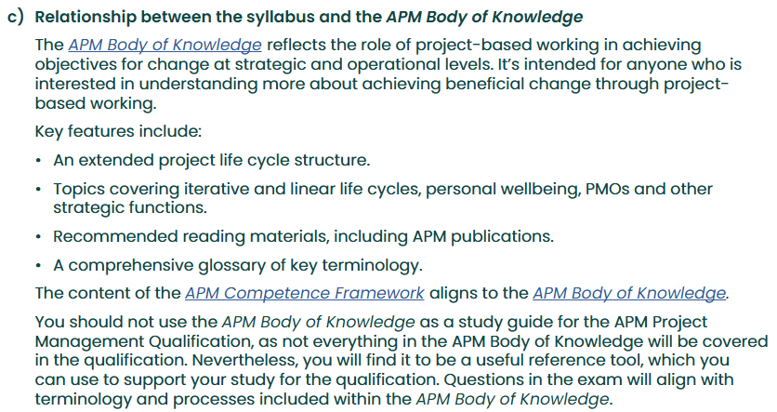
The APM Body of Knowledge (APMBoK)

Slide 8
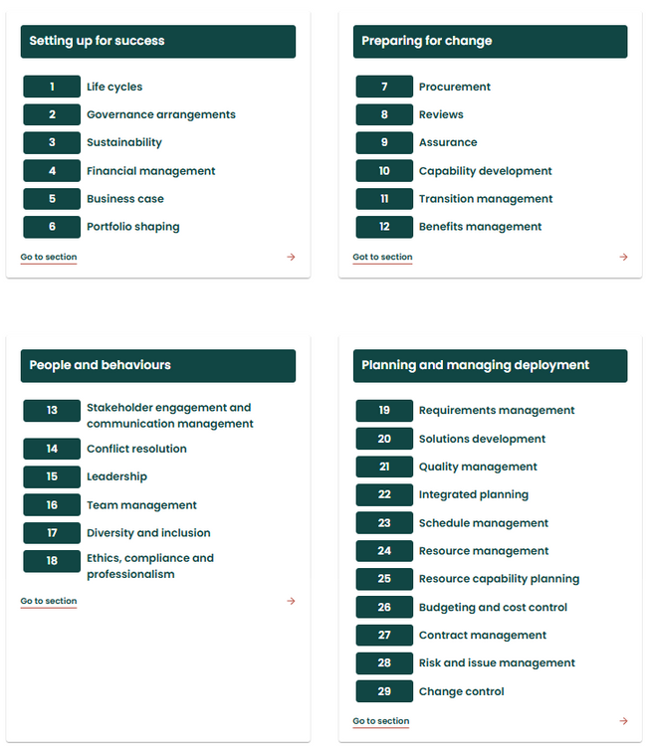
The APM Competence Framework
https://www.apm.org.uk/resources/find-a-resource/competence-framework/overview/
  Provides information about the competences that are required for effective project, programme and portfolio management
  Reflects both current good practice and the future needs of the profession and provides a benchmark for all those engaged in change initiatives
  Consists of 29 competences, each based around outcomes that project professionals need to achieve
  APM PMQ covers the 24 competences that are most relevant to project managers

Slide 9
A pharmaceutical company is developing a life-saving new drug which requires a specific raw ingredient, how would a procurement strategy support the election of an appropriate supplier?
  To manage the cost of the ingredient
  To ensure bulk savings are achieved by using existing suppliers
  To ensure the quality assurance of ingredients is defined
  To ensure the project is completed within the specified timeframe
  To manage potential supply chain risks
  To create a short-term saving for the project
Select one correct combination of the given statements:
a. 1, 4, 6
b. 2, 5, 6
c. 1, 3, 5
d. 3, 5, 6
Multiple Response Questions
20 questions
1 mark each
Click on/select the correct answer

Slide 10
An online retailer is redeveloping their website and is using a linear life cycle. During the project, the retailer requested several improvements to the website which were not in the original specification. The project manager will require technical specifications for the change __________.
a. At the point of request
b. During the detailed evaluation stage
c. During the decision-making stage
d. During the recommendation stage
The Project Manager insists on all the improvements being logged as a change request to __________.
a. Ensure alignment to the project’s scope
b. Encourage changes based on user feedback
c. Inform stakeholders of project progress
d. Redefine implementation timelines
Select from List Questions
5 questions
2 marks each
Select the correct answer from the drop-down list

Slide 11


Short Response
You have received a change request during a project that you are managing. List two pieces of information that you would require during the detailed evaluation stage of the change control process.
5 questions
2 marks each
Type out your answer
Long
Response
A software company is creating a new mobile application. They are exploring the options of using a linear life cycle versus an iterative life cycle. What considerations should they give to how the risk management process in the identification stage will differ between these life cycles? Your response should consider:
10 questions
5 marks each
Type out your answer
  The differences between the identification stages in iterative & linear life cycles
  The advantages and disadvantages of both approaches

Slide 12
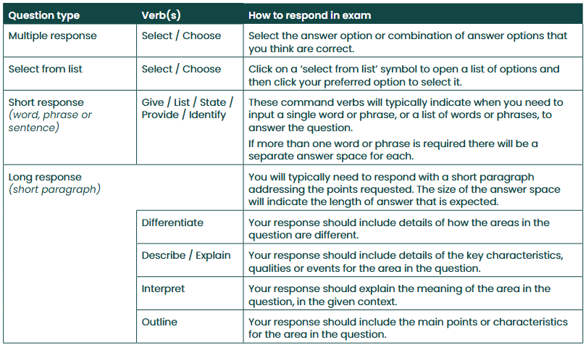
Command Verbs

Slide 13

The Day Before Your Exam
  Practise using the Sample Paper on the APM website
  Prepare your technology beforehand so that you can focus on the exam and not your system
  Double-check that you know how to access the exam and how to enter your answers for different question types
  Save the information with your link to the exam and login information to your computer desktop
  You require a camera (360-degree or embedded)

Slide 14

During Your Exam
  Please note that when you submit the first section, and stop for the break, you cannot return to the questions in the first section
  You can flag a question if you wish to return to it at any point during the current section of the exam

Slide 15

Tips and Tricks
  Make sure your exam environment is quiet
  Do not read the questions out loud
  Do not bring anything into your exam room with you
  Keyword identification
  Dummy answers
  Process of elimination

Slide 16

After Your Exam
  You’ll be advised of your results within eight weeks of completing your exam. You’ll be sent an email which confirms your result
  If your overall score is a borderline fail (i.e. within 1 of the pass mark) it will automatically be re-marked
  If you’re successful, you’ll also be sent a PDF certificate and an email from our partner Credly to claim your digital badge

Slide 17


THANK YOU FOR JOINING US
Please take a moment to leave us a review so that we can continue to host these sessions and help you ace your exams.

