Slide 1



www.itonlinelearning.com
Exam Prep Session

Slide 2

Exam Information
Duration: 60 minutes
Number of questions: 60
Marks: Each question is worth 1 mark. There are 60 available. There are no ‘trial’ questions and no negative marking.
Pass mark: 60% or higher - a raw score of 36 marks or above.

Slide 3

Reasonable Adjustments
  Used to support you if you are experiencing a short- or long-term condition or are regarded as disabled in terms of the Equality Act 2010
  Must be submitted to the APM Qualifications Team at least 12 working days before your exam date
  Made on an individual basis and will vary from person to person
  Examples of reasonable adjustments include:
i. Extra time and/or additional rest breaks.
ii. Use of a text reader or screen reader.
iii. Use of a scribe or reader.
iv. Permission to submit handwritten exam scripts.
v. Permission to use specialist equipment.

Slide 4
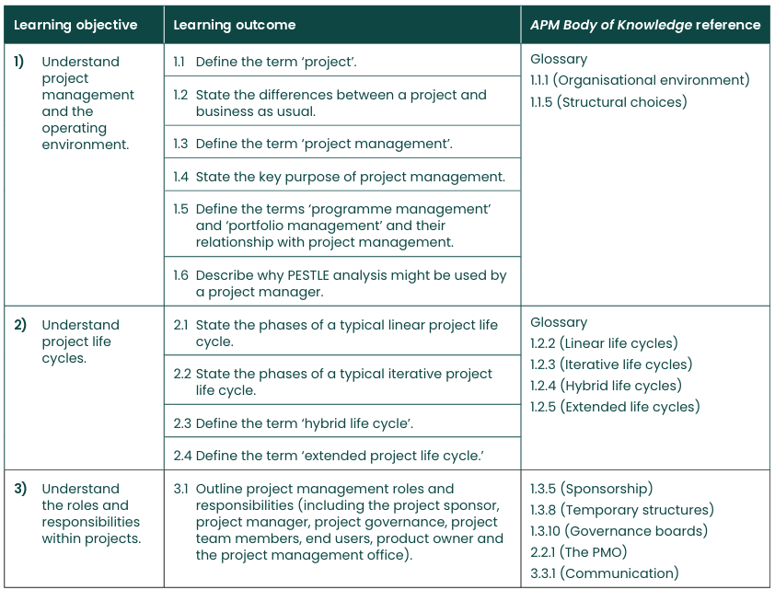
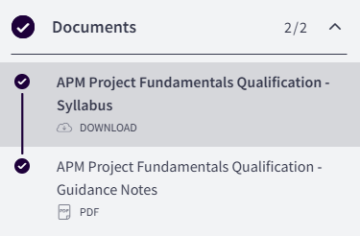
Syllabus
Your learning outcomes are listed from page 9 (APM PFQ Handbook)

Slide 5

Exam Coverage
All the learning objectives and learning outcomes in the syllabus for the APM Project Fundamentals Qualification will be assessed in your exam with one learning outcome assessed twice.

Slide 6

Glossary of Terms
  Please email your tutor for the APM Glossary of Terms if you do not already have it
  Use this glossary for keyword identification and to make sure you are confident in your knowledge of these terms before your official exam

Slide 7
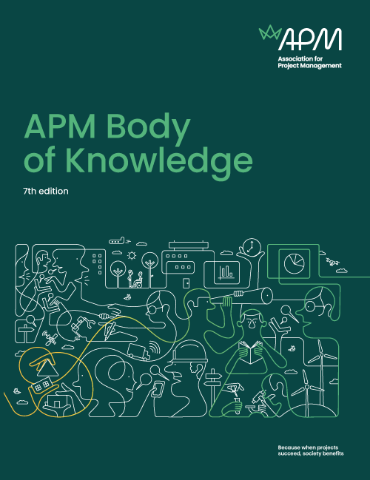
The APM Body of Knowledge (APMBoK)
You should not use the APM Body of Knowledge as a study guide for the APM Project Fundamentals Qualification, as not everything in the APM Body of Knowledge will be covered in the qualification.
Nevertheless, you will find it to be a useful reference tool, which you can use to support your study for the qualification. Questions in the exam will align with terminology and processes included within the APM Body of Knowledge.

Slide 8


Query
“Which of the following…?”
“Project management can be defined as….”
Complete the Statement

Slide 9

Missing Word
“The five phases of the extended project life cycle are: concept, definition, __________, handover and closure and benefits realisation.”
Which of the following are phases in an iterative project life cycle?
1) Concept
2) Feasibility
3) Deployment
4) Development
3 and 4 only
1, 2, and 3
List
1 and 2 only
2, 3, and 4

Slide 10
Command Verbs
Verb | Definition
Differentiate | Recognise or determine what makes something different.
Define | Give the nature, scope or meaning (from the APMBoK 7th Edition).
Describe | Give an account, including all relevant characteristics, qualities & events.
Explain | Give an account of the purpose(s) or reason(s).
Outline | Set out the main points/characteristics.
State | Express the details without elaboration.

Slide 11

The Day Before Your Exam
  Practise using the Sample Paper on the APM website
  Prepare your technology beforehand so that you can focus on the exam and not your system
  Double-check that you know how to access the exam and how to enter your answers for different question types
  Save the information with your link to the exam and login information to your computer desktop
  You require a camera (360-degree or embedded)

Slide 12

During Your Exam
  Follow the guidance provided by your invigilator/proctor
  Perform a security check
  Keep your ID on hand
  Enter the keycode - provided either on screen or by an invigilator
  Do NOT navigate away from the exam delivery page, have any other applications open, or leave the proctor examination page
  You can flag a question if you wish to return to it at any point during the current section of the exam

Slide 13

Tips and Tricks
  Make sure your exam environment is quiet
  Do not read the questions out loud
  Do not bring anything into your exam room with you
  Keyword identification
  Dummy answers
  Process of elimination

Slide 14

After Your Exam
  You’ll be advised of your results immediately after completing your exam.
This is a preliminary result - you will receive confirmation of your result after 2 weeks. You will also be sent a PDF certificate and a digital badge from Credly.

Slide 15

Question 1
Which of the following best describes a project according to the APM Body of Knowledge 7th Edition?
  A routine operational activity with predictable outcomes
  A unique, transient endeavour undertaken to achieve planned objectives
  An ongoing business process with an indefinite duration
  A series of repetitive tasks aimed at maintaining the status quo

Slide 16

Question 2
Which of the following best describes the primary purpose of project management?
  To ensure all stakeholders are satisfied with the project outcome
  To maximise profits for the organization undertaking the project
  To apply knowledge, skills, tools, and techniques to project activities to meet project requirements
  To complete the project as quickly as possible, regardless of quality or cost

Slide 17

Question 3
Which of the following is NOT typically a responsibility of the project sponsor?
  Securing funding for the project
  Approving major changes to the project scope
  Creating detailed project schedules and work breakdown structures
  Ensuring the project aligns with organisational strategy

Slide 18


THANK YOU FOR JOINING US
Please take a moment to leave us a review so that we can continue to host these sessions and help you ace your exams.

