Slide 1



www.itonlinelearning.com
Exam Prep Session

Slide 2

Exam Information
Duration: 60 minutes
Number of questions: 50
Marks: Each question is worth 1 mark. There are 50 marks available. There are no ‘trial’ questions and no negative marking.
Pass mark: 55% or higher – a raw score of 28 marks or above

Slide 3
Reasonable Adjustments
Requests for additional time up to 25% of total examination time, a reader or a scribe should be submitted no later than 5 business days before any PeopleCert examination.
Requests for all other reasonable adjustments should be submitted no later than 10 business days before any PeopleCert examination. For these requests, we ask that the Reasonable Adjustments Request Form is submitted to ensure we have the additional information required to process the request as swiftly as possible.
We will review requests after the required submission date exceptionally.

Slide 4
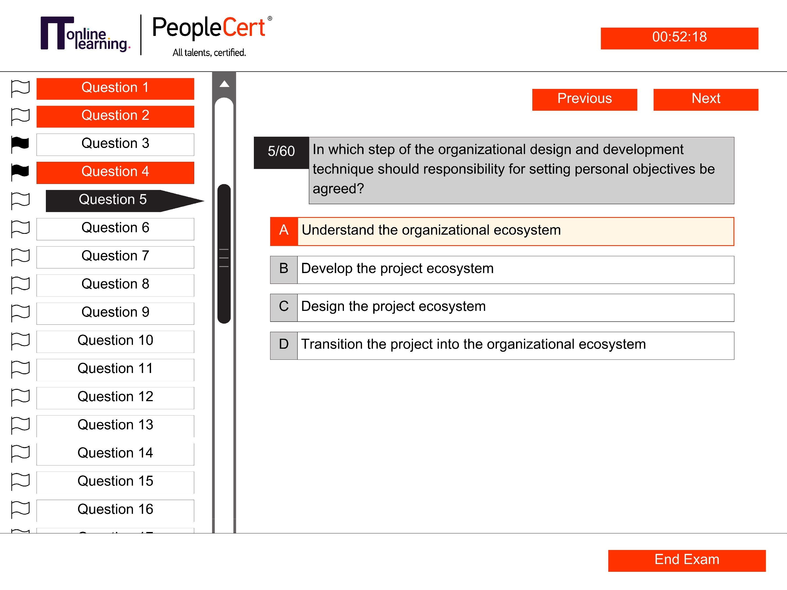
Exam Layout

Slide 5
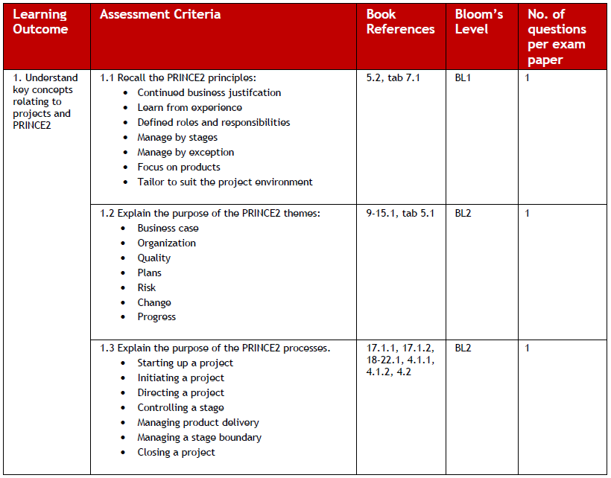

Your Syllabus
Make your notes based on this syllabus, don’t transcribe the course!

Slide 6
Tips & Tricks
Learning Objective | Marks
1. Understand key concepts related to projects and PRINCE2 | 5
2. Understand key concepts relating to projects and PRINCE2 Agile | 5
3. Understand how PRINCE2 principles, themes, processes, and management products are tailored and/or applied in an agile context | 22
4. Understand the agile ways of working, key terms and techniques | 13
5. Understand the focus areas in an agile context | 5

Slide 7

During Your Exam
  Make sure your exam environment is quiet
  Do not read the questions out loud
  You require a camera (360-degree or embedded)
  The door to the room you are in must be visible throughout your exam
https://www.peoplecert.org/ways-to-get-certified/examshield-guidelines
  Do not bring anything into your exam room with you
  Keyword identification
  Dummy answers
  Process of elimination
  Accessing your digital manual

Slide 8

Learning Outcome 1
Recall the PRINCE2 principles

Slide 9

  Continued business justification
  Learn from experience
  Defined roles and responsibilities
  Manage by stages
  Manage by exception
  Focus on products
  Tailor to suit the project environment

Slide 10
Learning Outcome 1
Explain the purpose of the PRINCE2 themes

Slide 11

  Business Case
  Organisation
  Quality
  Plans
  Risk
  Change
  Progress

Slide 12








GOOD LUCK!
Customer-Approved Service Since 2007
Bolster Income Potential and Job Security
Endorsed Qualification & Reputation
Finance That Suits Your Lifestyle
Tailored Advice and Consulting
Full Student Success Team
1st Floor Front Suite, Unit 10, Conqueror Court, Sittingbourne, Kent, ME10 5BH
0800 160 1124
www.itonlinelearning.com
021 235 7770
enquiries@itonlinelearning.com

