Slide 1



www.itonlinelearning.com
Practitioner Exam Prep Session

Slide 2

Exam Information
Duration: 2.5 hours
Questions: 70 scenario-based multiple-choice questions
Marks: Each question is worth 1 mark. There are 70 marks available. There are no ‘trial’ questions and no negative marking.
Pass Mark: 60% or higher - a raw score of 42 out of 70
Material Permitted: The “PRINCE2® 7 Managing Successful Projects” manual may be used. You may also bring 4 blank pieces of A4 paper into your exam.

Slide 3
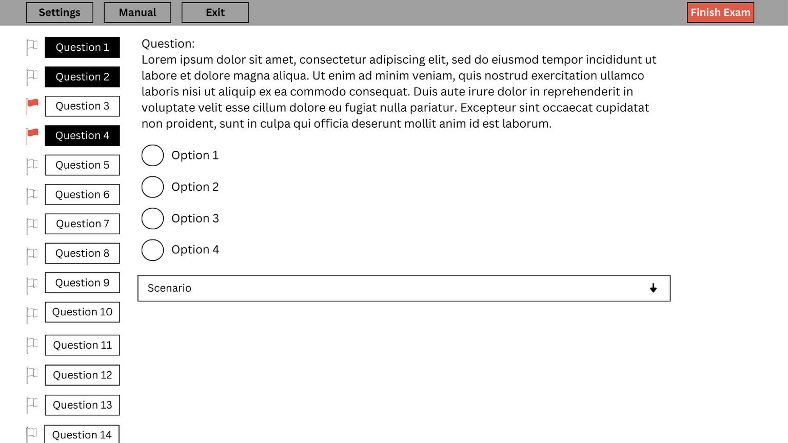

Exam Layout

Slide 4

If you have a hardcopy manual...
You may:
  Use Post-it® notes as long as the titles are brief
  Make notes in your manual (on blank pages or in margins)
You will NOT be permitted to:
  Add more pages to the manual
You should:
  Highlight the corresponding content when following your syllabus and the manual references

Slide 5

If you have a digital manual...
  You will be able to access your manual in the official exam using the button on the top left-hand corner that reads “Official Manual” of your exam screen
  Anything you have highlighted in your digital manual on the PeopleCert portal will be highlighted in your official exam
  You will still be able to use the search functionality as you do with your current digital manual
  You should highlight the corresponding content when following your syllabus and the manual references
  You may view your full eBook on a second portable device such as Smartphones, Tablets, or Laptops

Slide 6

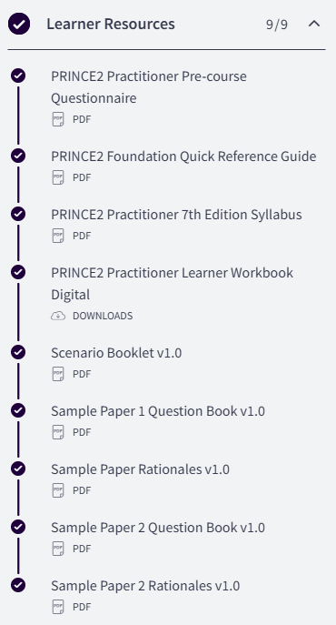
Key Resources

Slide 7

Glossary of Terms
  You should have access to the full glossary in your manual from page 324, but you can also access the glossary from the PRINCE2 v7 Foundation course as a separate PDF
  Use this glossary for keyword identification and to make sure you are confident in your knowledge of these terms before your official exam

Slide 8
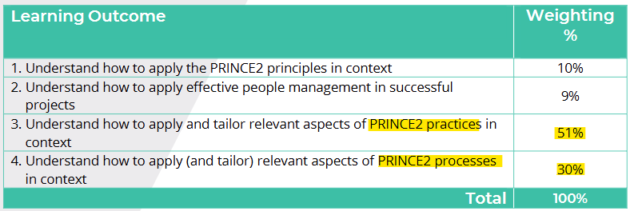
Tips and Tricks

Slide 9
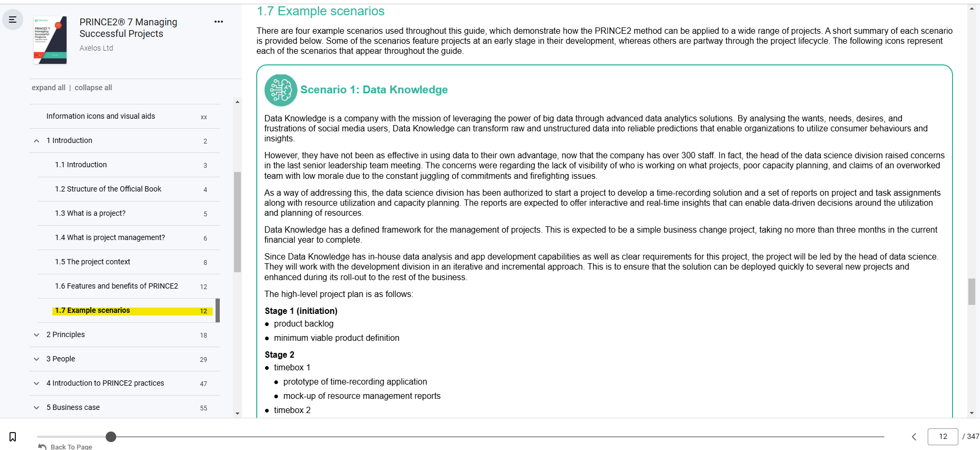
Tips and Tricks

Slide 10

During Your Exam
  Make sure your exam environment is quiet
  Do not read the questions out loud
  You require a camera (360-degree or embedded)
  The door to the room you are in must be visible throughout your exam
https://www.peoplecert.org/ways-to-get-certified/examshield-guidelines
  Try not to use the manual for every question
  Keyword identification
  Dummy answers
  Process of elimination

Slide 11
Project Scenario: NowByou
NowByou is a not-for-profit organisation that works with local communities to eliminate discrimination of any kind and help advance the international human rights system through local and targeted interventions.
NowByou forms, chairs, and equips networking and support groups, where anyone who has experienced discrimination can share their experiences and thoughts in a safe and empowering space. Additionally, NowByou is one of the few non-governmental organisations (NGOs) in the country that works directly with police forces to co-develop campaigns that encourage the reporting of discriminatory incidents to authorities.
Recent research has shown that discrimination against marginalised groups, particularly the homeless and refugees, is growing at a concerning rate. The increase in discrimination has led NowByou to believe that a new six-month campaign is required to address this issue.
They have decided to run the campaign as a project, aiming to both raise awareness of this type of discrimination and reinforce their own brand recognition (as NowByou is highly dependent on the goodwill of donors and financial aid from partners).

Slide 12
Project Scenario: NowByou
The project management maturity of the organisation is very low, with no standardised processes or templates in place. For that reason, NowByou has contacted a professional project manager with a track record of successful delivery in the not-for-profit sector who will be responsible for:
  developing the initial project management documentation
  advising and coaching the NowByou director of campaigns, who is sponsoring the project
  mentoring the staff member who will be appointed as project manager
  advise the project team how to use a variety of media (TV, press, and social networks) for this, and other future projects.

Slide 13
There is a high-level view of the project, but this is to be confirmed, as pre-project discussions are still occurring:
Stage 1 (initiation)
  business case
  project initiation documentation
Stage 2
  campaign high-level requirements gathering
  options analysis
Stage 3
  implementation of chosen option(s)
  closure.
The main output from the project will be a delivered multi-channel campaign.

Slide 14
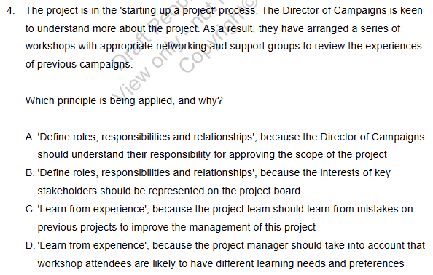

Slide 15
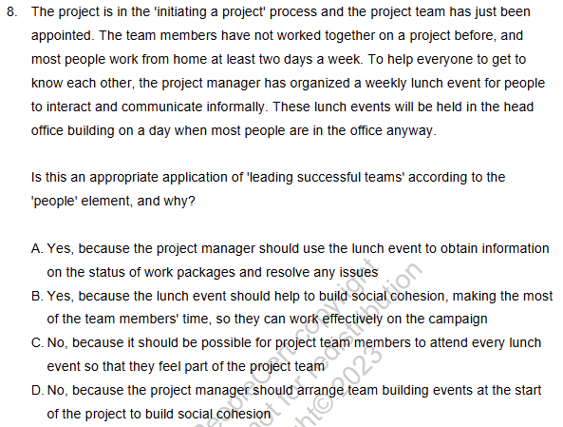

Slide 16
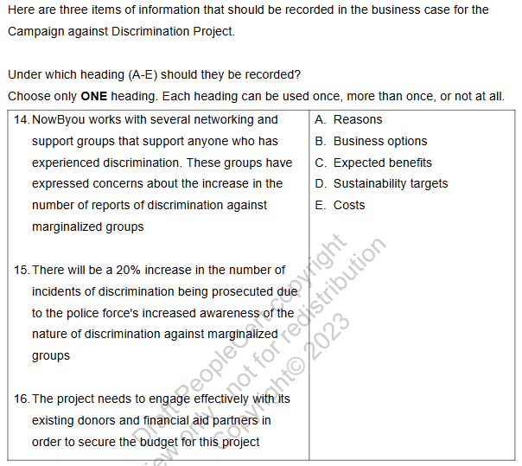

Slide 17
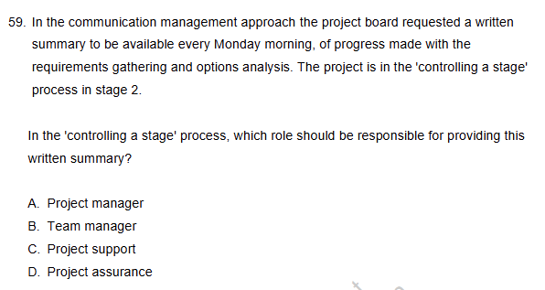

Slide 18

THANK YOU FOR JOINING US
Please take a moment to leave us a review so that we can continue to host these sessions and help you ace your exams.

